Slide 1
LayerTwo Labs
Making every transaction a Bitcoin txn.
LayerTwo Labs is raising $ 5 million in their 2nd round, to further the mission of “making every transaction a Bitcoin txn”.
Drivechains foster competition among software devs, and allow different users to run different software.
Working demos of this software have already been built, and the idea has high-profile endorsements (LayerTwoLabs.com/friends).
Rival L2s are not merged mined, and thus doomed – nonetheless these doomed L2s have raised hundreds of millions of dollars.
If BTC does not innovate, it may be replaced (and go to $0).
paul@layertwolabs.com
Twitter: @truthcoin
Telegram: @psztorc
Signal: (321) 248-1686
Update (10/21/2024): 10% filled
($500k, of the 5M has been signed & wired.)
9/12/2024

Slide 2
Mission
We aim to make every transaction in the world, a Bitcoin transaction, thus ensuring Bitcoin’s survival.
We deliver –and monetize– the ultimate Bitcoin experience.
For example, with our software, we…
  …scale BTC to 8 billion users, immediately,
  …add full privacy to Bitcoin txns,
  …ossify L1 in a smart, realistic, sustainable way,
  …push development into optional modular add-ons (L2s, UX, frontends, wallets, performance, etc) allowing competition, disruptive innovation, dissident genius, and rapid progress,
  …release software for “real” use-cases (prediction markets, tokens/assets, and naming), in addition to emulating all popular Altcoins,
  …secure bitcoin, via $X00B /year in merged-mining revenue.
...all without altering the L1 Bitcoin software.

Slide 3
Problem
Huge imminent transformation:
  Selling vinyl records, vs free music on internet.
  Many experimental techs, vs one optimal tech that is adopted by 8 billion users.
Innovation & adoption will either make, or break, BTC.
For more on this important topic, see my 2023 PlebFi presentation.
Innovation
  Innovation created Bitcoin – so, it could create something better, any day now!
  Innovation is unpredictable – no one predicted the invention of Bitcoin ...the next great idea will also be a surprise.
  ... is hard to assess. For every genius inventor, there are 500 frauds and cranks.
  ... is always a risk. Every improvement is a change – it could therefore, instead be a mistake, an attack vector, or sabotage.
  ... is always a dissent from a prevailing orthodoxy. Most cypherpunks / Austrians hated Bitcoin at first – all good new ideas will be hated by Bitcoiners at first.
  ... always reorders status in a community. Better scaling would put Lightning out of business, better privacy would put CoinJoin out of business, improved self-custody would put BitGo out of business. Better UX puts educators out of business, etc. These are natural enemies of innovation. Innovation never has consensus.
Blockchain tech is improving fast.
  99% of new projects are scams – but this has blinded people to the true pace of progress.
  In 3-5 years, it will be possible for anyone to launch a new coin that is [1] globally scalable, [2] fully private, [3] capable of replacing fiat payment systems, all on [4] layperson hardware/internet.
  After that, only network effects will matter. Whichever coin innovates most on adoption will then win.
  Soon (probably by 2035), only one currency will remain. BTC will either go to $200T, or $0.
Meanwhile, Bitcoin is gripped by a decel mind virus.
  Lightning is a failure, Bitcoin Core is a lazy, self-serving corrupt monopoly, most podcasts/media repeat the same tropes.
  Widespread complacency, and unwillingness to build on Bitcoin. A desire to insert custodians and middlemen, replacing the open source software (stealing fees from their rightful owners: the proof-of-work miners; very problematic long-term).
  Even adoption has gone backwards in innovation. Previous good ideas (purse.io, BitPay) are forgotten, instead bad ones are promoted.
  All this acts to “decelerate” progress in Bitcoin.
How do we attract all the good ideas, whilst repelling the bad ones?
What about different people who want different tradeoffs? How do we adopt them all at once?

Slide 4
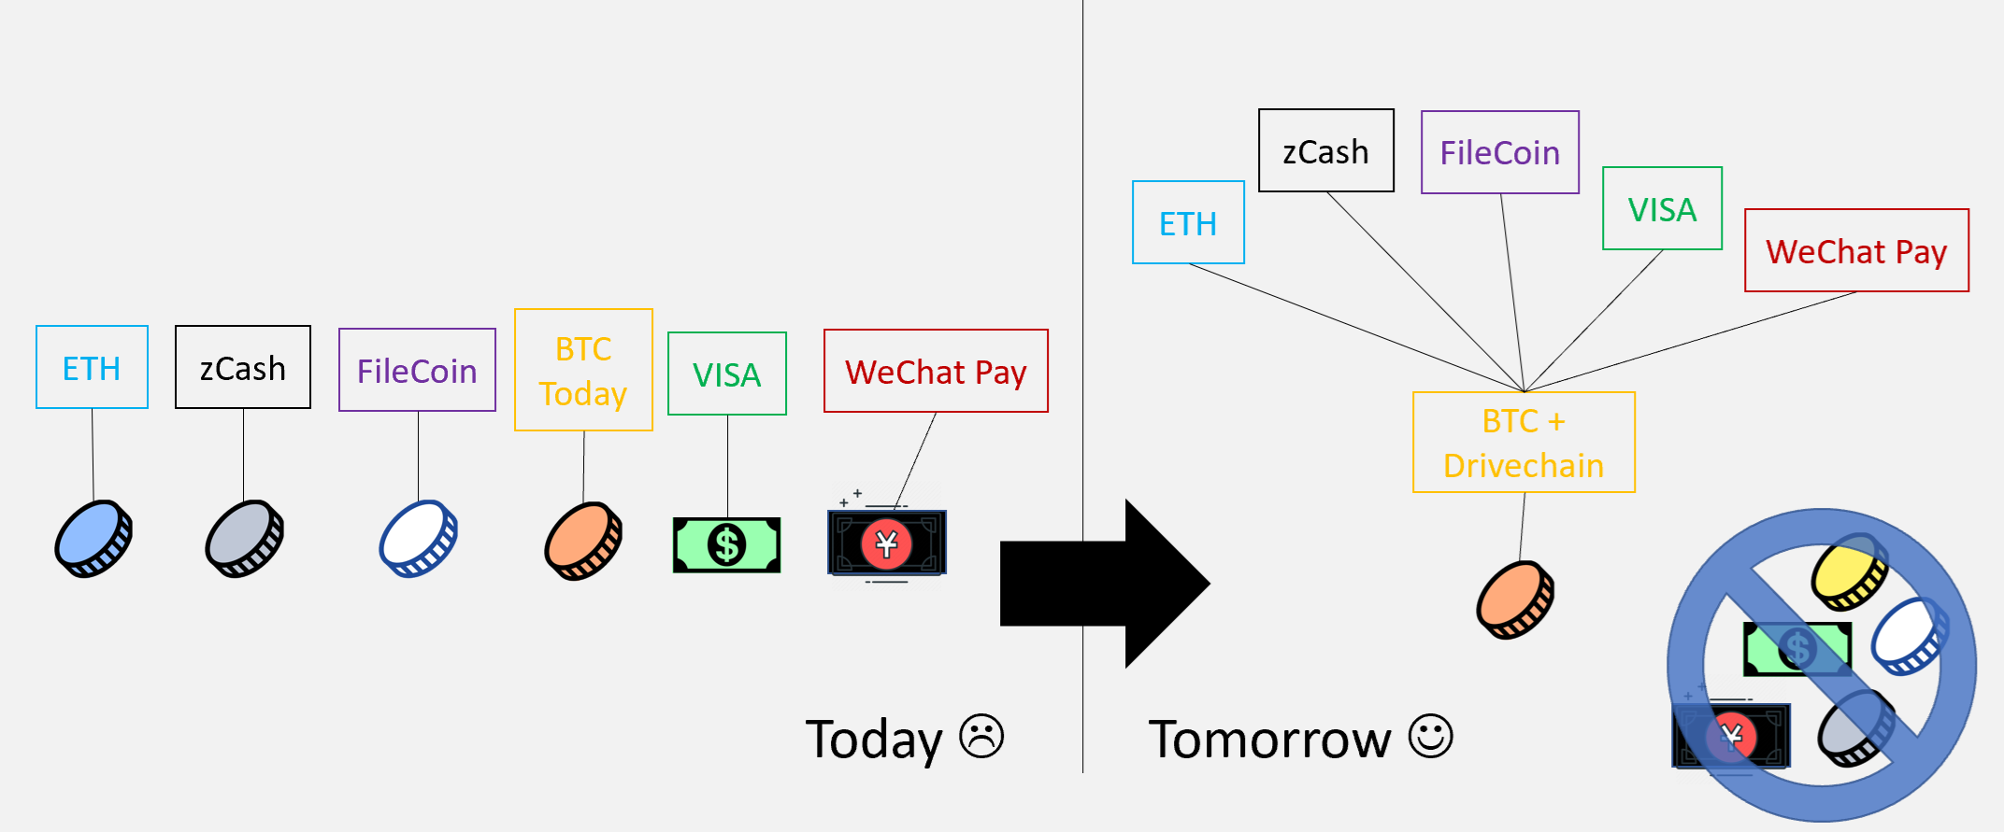
Solution
Drivechains -- Optional L2s, on Bitcoin, of all shapes and sizes.
Devs compete, users win.
Different users can run different software – (ie, Blocksize war problem).
Merged-mining for all chains, fee-revenues go L1 miners.
Activate via “CUSF” – no need to modify Bitcoin Core.

Slide 5
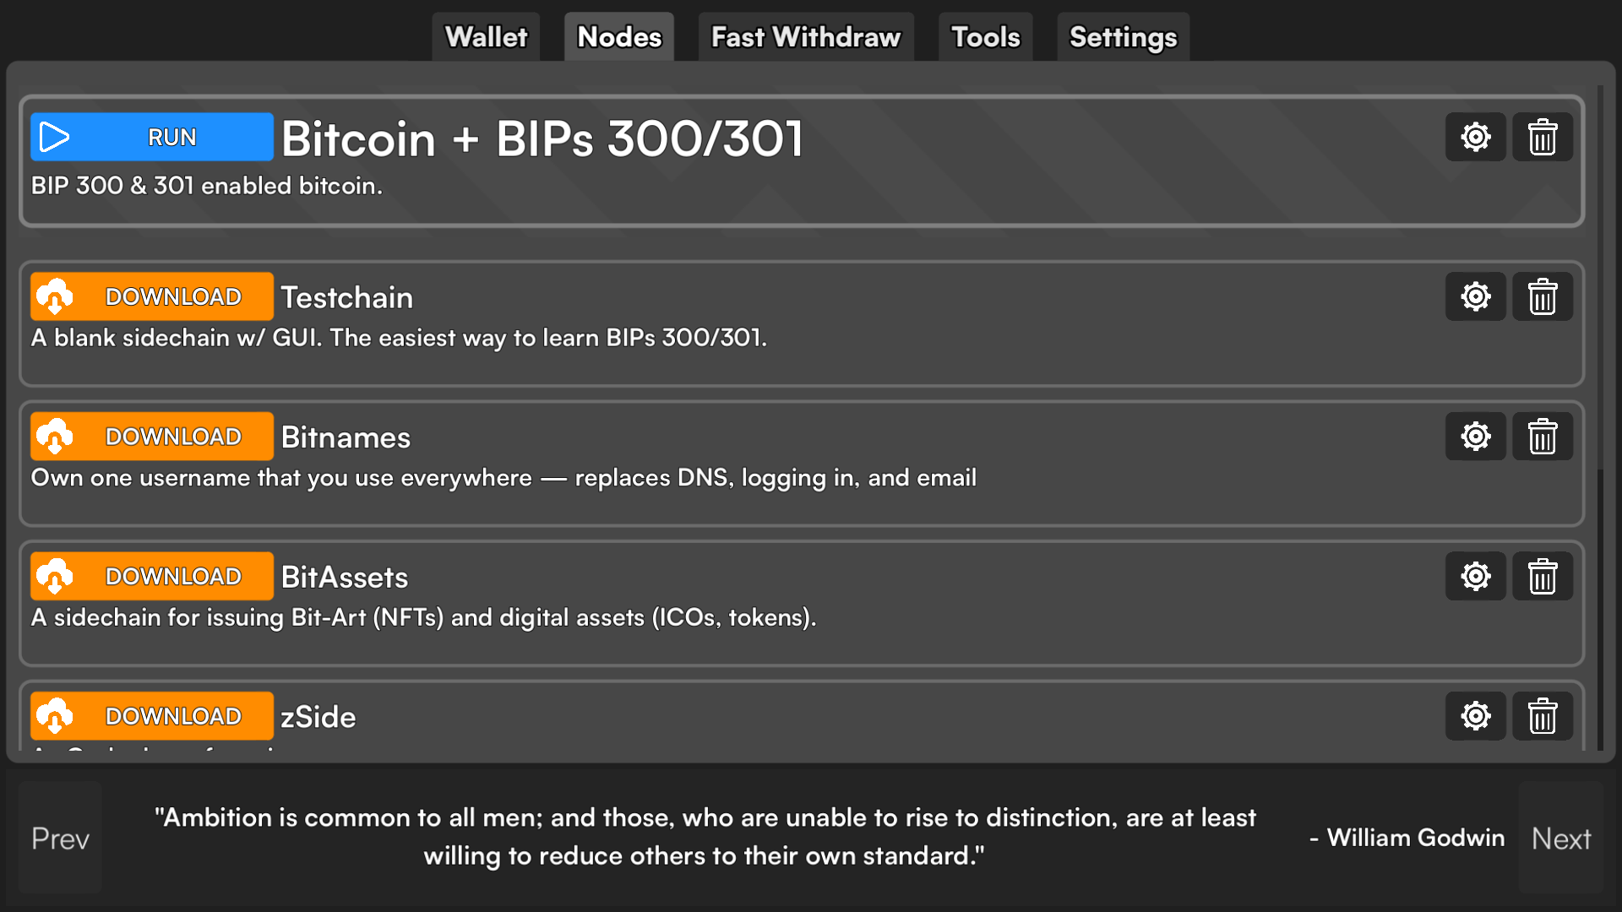
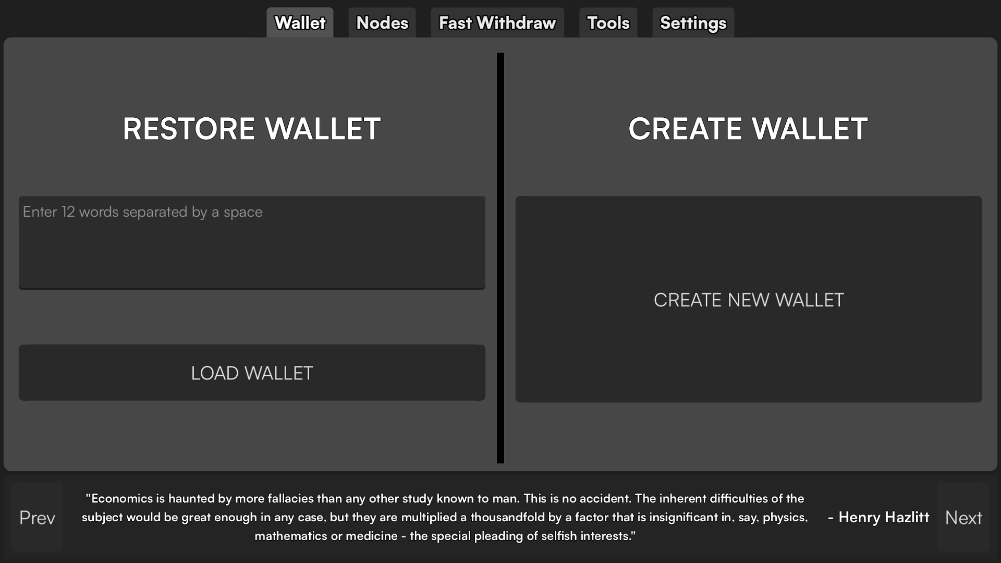
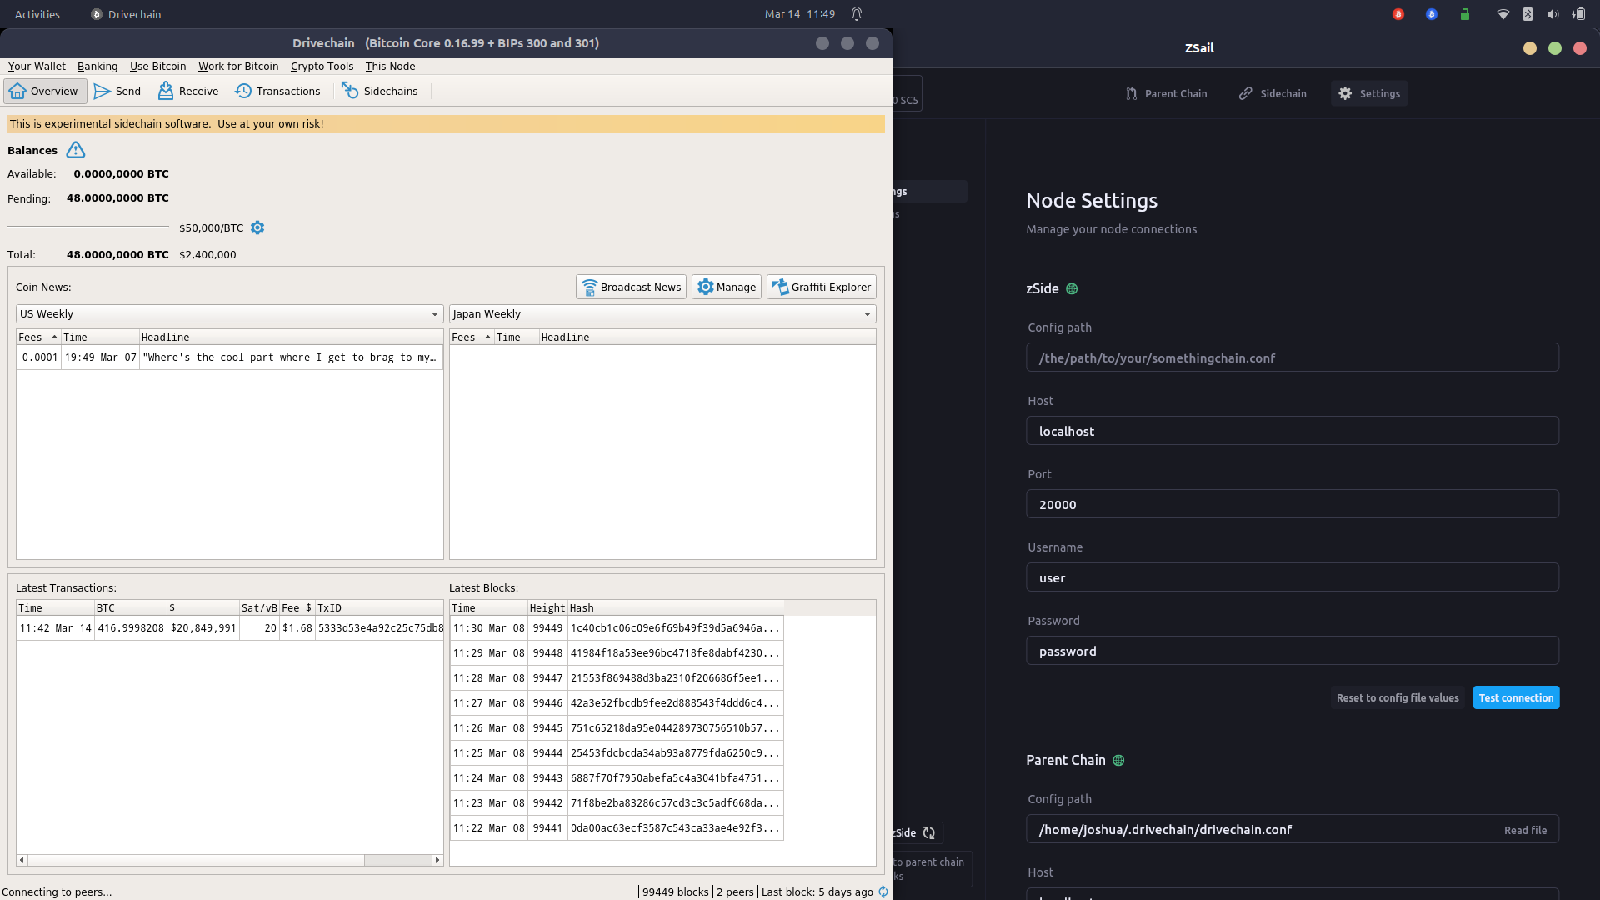
Demo
LayerTwoLabs.com/download
Unlike most projects, we actually have working software.

Slide 6




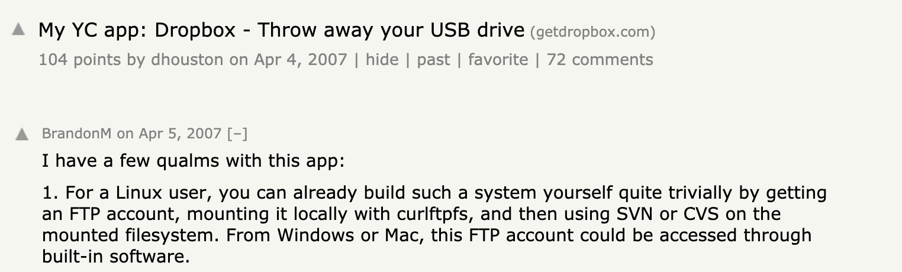

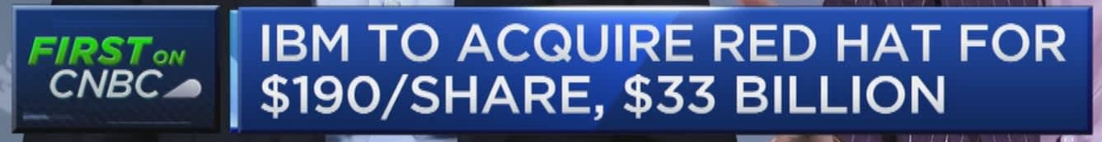
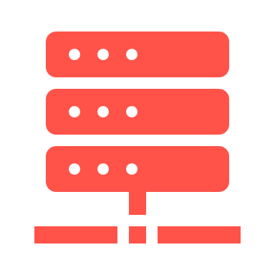
Market Potential
These are enormous numbers … but what business strategy would monetize these?
Enormous TAMs
Coin | A globally dominant coin is worth $228 trillion ($11M/coin).
Mining | …and would have fee revenues of $640 B billion per year (growing 6.2% YoY).
ICANN | ICANN annual revenue is routinely $100M+.
Oracles | Likely worth at least $10B.
BitAssets | OpenSea still worth $1B+, even after collapse.
Click links for more info.
Infamous hackernews comment:
Complimentary innovations:
  Validator hardware/software (ASIC chip for nodes).
  Sovereign anonymous server space.
  Consulting / UX as internet switches to blockchain.
Redhat: open source for enterprise

Slide 7
Business Model / Strategy / Comparative Advantage
Our strategy: monopolize part of the tech stack, and commodify everything else.
Our “free” software is still economically useful to us, via complements.
These posts more details:
  Commoditize Your Complement, by Gwern Branwen
  Technology Holy Wars are Coordination Problems, by Gwern Branwen
  GARP and IMEX, by Paul Sztorc
  BitNames, BitAssets, zSide, by Paul Sztorc
  Thunder, and All the worlds txns, by Paul Sztorc
  BitcoinHivemind.com, by Paul Sztorc
  The Revenge of Patoshi, by SD Lerner
  The Straussian Moment, by Peter Thiel
No offense, but if I explain it too well, then you wouldn’t need me!
Tech Valuations are tricky to understand.
  Musk (2022) bought Twitter for $44 B – not for its tech stack, but for its userbase.
  Twitter’s tech stack would cost 10-50 M to replicate. But the userbase? 1000x more valuable.
Please talk to the Round 1 investors for more info on this (if desired).

Slide 8
Traction
Bip300 has not activated yet – but other than that, we have about as much traction as is possible.
50+ High-Profile endorsements – LayerTwoLabs.com/friends.
Working software – LayerTwoLabs.com/downloads.
Track record of delivering – in the last 19 months:
  Payments sidechains – scaling to 8 billion people.
  zCash clone ; ETH clone.
  BitAssets ; BitNames ; Bitcoin Core + CTV / APO / opvault.
  User friendly Launcher. CoinNews.
  Signet “play money” Testnet, as a demonstration.
  CUSF (Bip300 with no pull request to Bitcoin Core).
People are finally ready to admit –
  - that LN has failed… after Paul pointed it out 2.5 years ago.
  - that other coins are useful.
  (This has set the stage for “Bitcoin Season 2”.)
Paul named CoinDesk’s #27-most influential in crypto, for year 2023.
Adam Back
Robin Linus
René Pickhardt
Fiatjaf
Super Testnet
Ben Arc
Junseth
Hampus Sjöberg
Luke Dashjr
Michael Tidwell
David Bailey
Dan Held
Vlad Costea
Pete Rizzo
Bruce Fenton
Edan Yago
Guy Swann
Jameson Lopp
John Light
Andrew Bailey
Troy Cross
Brad Mills
Eric Wall
Nic Carter
Ari Paul
Alex Kravets
Timoleon Moraitis
Sergio D Lerner
Gabriel Kurman
Sjors Provoost
Marshall Long
Ruben Somsen
Charlie Shrem
Aaron van Wirdum
Stewart Mackenzie
Alexei Zamyatin
…

Slide 9
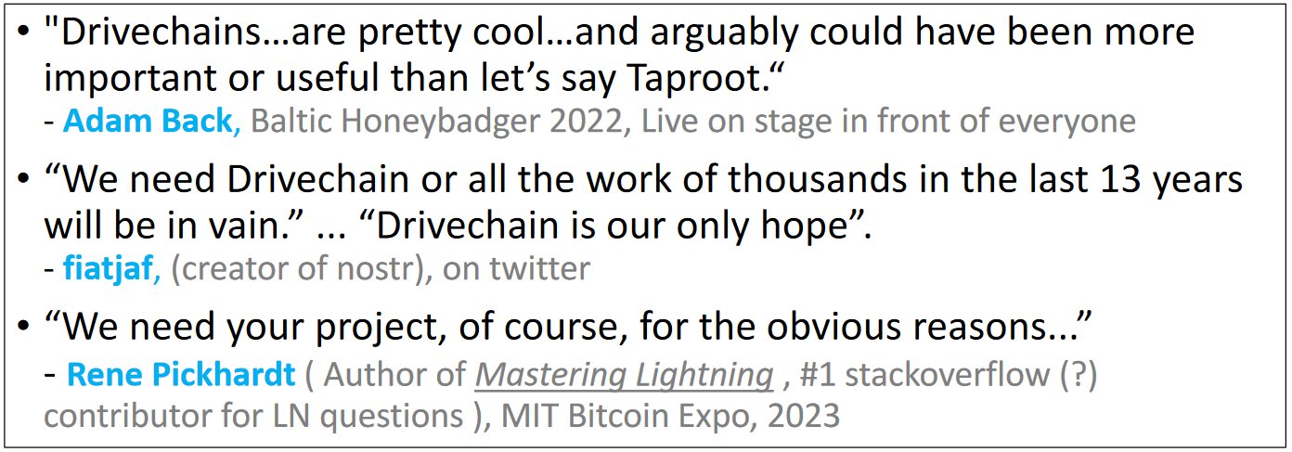
Traction
Bip300 has not activated yet – but other than that, we have about as much traction as is possible.
50+ High-Profile endorsements – LayerTwoLabs.com/friends.
Working software – LayerTwoLabs.com/downloads.
Track record of delivering – in the last 19 months:
  Payments sidechains – scaling to 8 billion people.
  zCash clone ; ETH clone.
  BitAssets ; BitNames ; Bitcoin Core + CTV / APO / opvault.
  User friendly Launcher. CoinNews.
  Signet “play money” Testnet, as a demonstration.
  CUSF (Bip300 with no pull request to Bitcoin Core).
People are finally ready to admit –
  - that LN has failed… after Paul pointed it out 2.5 years ago.
  - that other coins are useful.
  (This has set the stage for “Bitcoin Season 2”.)
Paul named CoinDesk’s #27-most influential in crypto, for year 2023.
Adam Back
Robin Linus
René Pickhardt
Fiatjaf
Super Testnet
Ben Arc
Junseth
Hampus Sjöberg
Luke Dashjr
Michael Tidwell
David Bailey
Dan Held
Vlad Costea
Pete Rizzo
Bruce Fenton
Edan Yago
Guy Swann
Jameson Lopp
John Light
Andrew Bailey
Troy Cross
Brad Mills
Eric Wall
Nic Carter
Ari Paul
Alex Kravets
Timoleon Moraitis
Sergio D Lerner
Gabriel Kurman
Sjors Provoost
Marshall Long
Ruben Somsen
Charlie Shrem
Aaron van Wirdum
Stewart Mackenzie
Alexei Zamyatin
…

Slide 10
Go-To-Market
Very easy - once people learn of this, they are going to want it!
Miners
  Always want more money – they’ll have no choice but to adopt. In the future, 99% of miner revenue will come from merged mined drivechains.
  CUSF allows miners to adopt Bip300 very easily – same as ordinals.
  If +50% hashrate runs CUSF, other miners will be forced to follow along, or else they will not be competitive.
Devs
  Always want to tinker – no more slow broken Core process or Altcoin stigma/drama – just ship and get users.
  We have sidechain templates + frontends finished already – they just need to tinker and customize.
Users
  Always want: low fees, great features, responsive devs.
  Competition is what protects the users and ensures they get the best UX.
Coin-investors
  Want the “which coin will win” question to finally go away.
  Want the perfect balance struck, between ossification (property rights) and innovation (good updates).
Word travels fast, in this industry.
When people see our actual product – with a GUI, awareness will explode!
The (relatively small) raise of $3M in 2022 was enough to attract enormous attention; this time with $5M + CUSF it will be 10x larger or even 100x.

Slide 11
Team
We have 9 of the best people I could find! Most are Bitcoin Ogs themselves.
Founders (all technical)
  Paul Sztorc – Author BIPs 300/301, CUSF. CoinDesk #27th most influential in Crypto, sites: drivechain.info BitcoinHivemind.com truthcoin.info. Fmr software engineer at Yale Econ department.
  CryptAxe – Bitcoin Core developer (2016-Present; 0.14, 0.15, 0.16). Creator of sidechain template, BitAsset sidechain, zCash sidechain GUI.
  Nikita Chashchinskii – Creator of the zCash SidechainBip300 Bridge Module, EVM Sidechain, and engineer for CUSF.
Team
  2 staff engineers
  3 contractor engineers
  1 support

Slide 12
Roadmap / The Plan
Build the best possible software (nodes, wallet, features, UX, etc).
Launch it as a test network, to show the world what it can do.
Watch as Bitcoin becomes great, by adopting our software (or, at least, the test network does).
Already Done (Past 19 months)
Payments sidechains – scaling to 8 billion people.
zCash clone ; ETH clone.
BitAssets ; BitNames ; Bitcoin Core + CTV / APO / opvault.
User friendly “click button UX” Launcher. CoinNews.
Website / educational materials / endorsements, etc.
Signet “play money” Testnet, as a demonstration.
CUSF “Core Untouched Soft Fork” (allowing Bip300 with no pull request to Bitcoin Core).
Next 6 Months
Cross-L1 coin-swap sidechain (eg “uniswap” sidechain).
ETH clone 12 second block time / staking.
Customized L1 Bitcoin Core node frontend / wallet.
Node performance contest / hackathon / event.
“Stratum V3” optimized mining pool / service.
Bitcoin Hivemind prediction markets sidechain.
ICANN “bridge” to import ICANN-names to BitNames.
Company Founded
Dec 2022

Slide 13
The Ask
We offer a much better deal than our competitors.
This round’s ownership rate (2.4%), multiplied by figures on slide #6 (this is strictly for reference only).
Now raising:
  $5 M for 213k shares (2.4%)
  Valuation: 5M /0.024 = 208 M
  Plus 60k tokens (0.31%)
  Token warrant: 1 token per 3.555 shares
Previous round (closed Dec 2022)
  $3 M for 533k shares (6.2%)
  Valuation: 5M /0.024 = 48 M
  Plus 140k tokens (0.72%)
  Token Warrant: 1 token per 3.809 shares
Topic From Slide #6 | Value * 2.4% | Result
Coin | 228T * 2.4% | $ 5.4 trillion
Mining | NPV(640Bg=6.2%r=10%) * 2.4% | $ 403 billion
ICANN | NPV($100Mr=10%) * 2.4% | $ 24 million
Oracles | $10B * 2.4% | $ 240 million
BitAssets | $1B * 2.4% | $ 24 million
$ 5 million →
Competitors | Raise(s) | Summary | L1 Miner fee-pass-through
Lightning Labs | 2.5 M (2018) + 10 M (2021) + 70 M (2022) = 82.5 M | Lightning is a dead end – many are already jumping ship. | 0%
Blockstream | 21 M (2014) + 55 M (2016) + 210 M (2021) = 286 M | A failure on every level. Enormous time & money spent -- but no useful result. Once employed 40+ engineers -- today, most have already quit. Liquid is a pointless multisig -- no tech and no users. Pivot to mining is a disaster -- no comparative advantage. | 0%
Stacks | 150 M (2022) = 150 M | STX token is probably too off-putting to users. The large raise will invite distraction and/or complacency into the org. I use their products everyday! Don’t you?? | 0%
All sub-100% L2s are ultimately doomed. Drivechains are 100% pass-through.

Slide 14
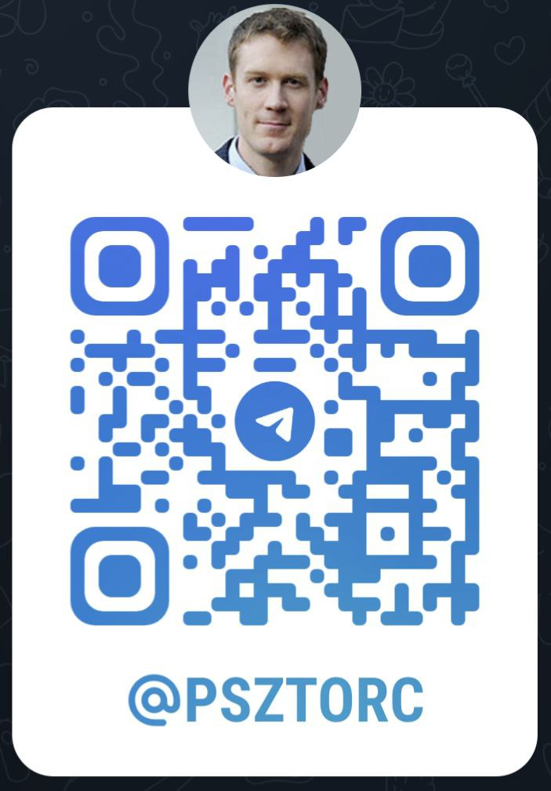
Details / Summary
Send: name + title + email/phone + mailing address + ticket size, to:
Accepted: USD, BTC, USDT
Mandatory accredited investor questionnaire (US) or Reg-S (non USA)
L2L is a Delaware C corp
Token warrant, from separate BVI entity
100% common stock (No preferred, etc)
L2L has zero debt, Current assets $1.9M
Default ticket size: $250k
paul@layertwolabs.com
Twitter: @truthcoin
Telegram: @psztorc
Signal: (321) 248-1686
Review
LayerTwo Labs is raising $ 5 million in their 2nd round, to further the mission of “making every transaction a Bitcoin txn”.
Drivechains foster competition among software devs, and allow different users to run different software.
Working demos of this software have already been built, and the idea has high-profile endorsements (LayerTwoLabs.com/friends).
Rival L2s are not merged mined, and thus doomed – nonetheless these doomed L2s have raised hundreds of millions of dollars.
If BTC does not innovate, it may be replaced (and go to $0).
Thanks for your attention.

